Slide 1
Module 2: Working with and understanding spatial data
Michael Otterstatter, PhD
Analytic Capacity Building Initiative: Workshop in Geospatial Methods
September 17-18, 2019, Calgary, Alberta

Slide 2
Outline
Background and concepts
Spatial data
Coordinate reference systems and projection systems
Spatial data in R
Illustrative example
R script: Working with spatial data
Discussion
Challenges in accessing and using spatial data
References and other resources

Slide 3
Background and concepts

Slide 4
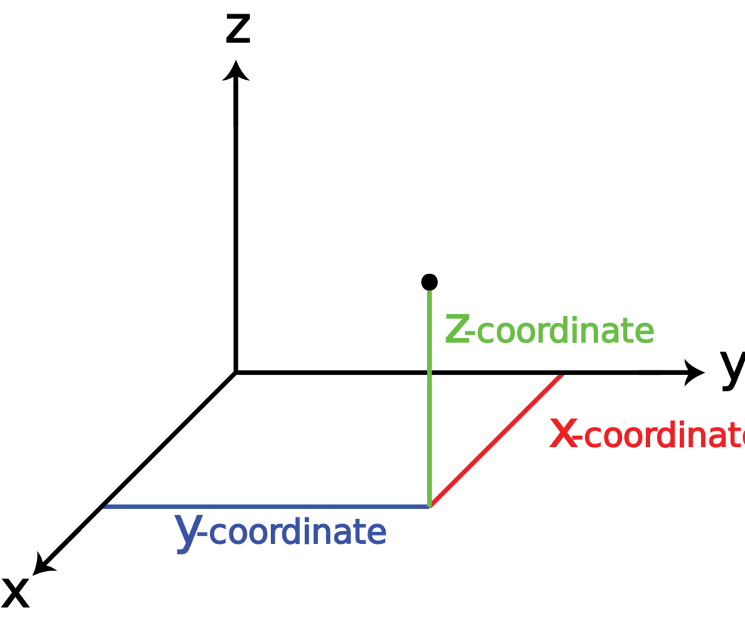
Spatial data
Background and concepts
Geospatial data are those data located in two or more dimensions – these additional dimensions provide additional information for analysis and understanding

Slide 5
Spatial data
Background and concepts
In geospatial analysis, the actual location of something is described using a georeference, typically a coordinate system
In addition to location, three essential aspects of geospatial data are
features (point, line, area or volume)
supports (size, shape and orientation of features)
attributes (characteristics or measurements associated with a feature)

Slide 6
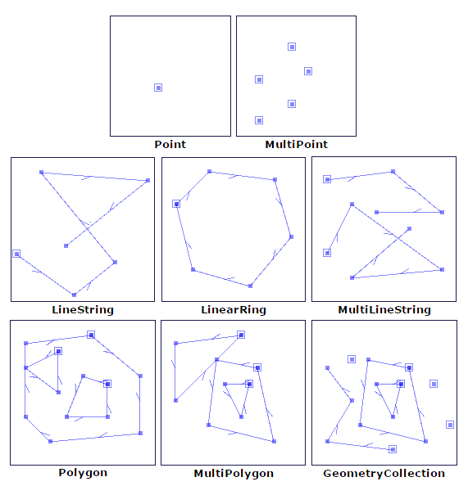
Spatial data
Background and concepts
Examples of ‘features’
Locations of residences, hospitals, services
Routes of streets, public transit, rivers
Health or census region, catchment, lake
https://automating-gis-processes.github.io/CSC/notebooks/L1/geometric-objects.html

Slide 7

Spatial data
Background and concepts
Briefly, let’s review a few aspects of geospatial data
vector and raster data
point and areal data
polygons
geocoding

Slide 8
Spatial data: vectors and rasters
Background and concepts
Vector data: representation of geographic features as points, lines, and polygons using coordinate pairs and ordered lists of vertices; attributes may be associated with each vector feature
e.g., summarised population characteristics (e.g., health, socio-demography, etc.) by census regions or other distinct boundaries
Raster data: geographic features are represented and stored as uniformly sized pixels; attributes are typically associated with each of these grid cells
e.g., satellite imagery and other remote sensing information

Slide 9
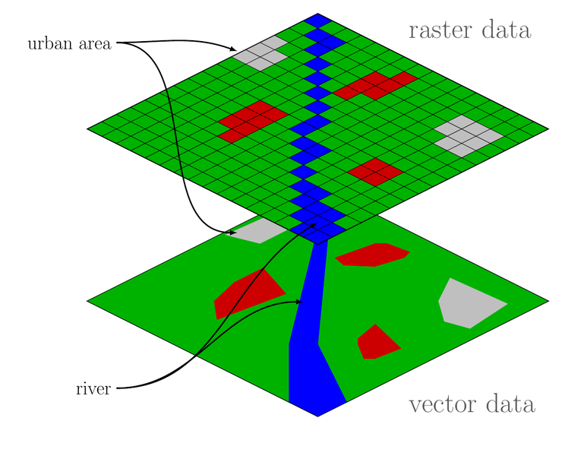
Spatial data: vectors and rasters
Background and concepts
https://commons.wikimedia.org/wiki/File:Raster_vector_tikz.png

Slide 10
Spatial data: vectors and rasters
Background and concepts
Both vector and raster data can be used together (or converted from one to the other), but vector data usually require much less computational memory and time
Here, we focus only on the manipulation, mapping and analysis of vector data

Slide 11
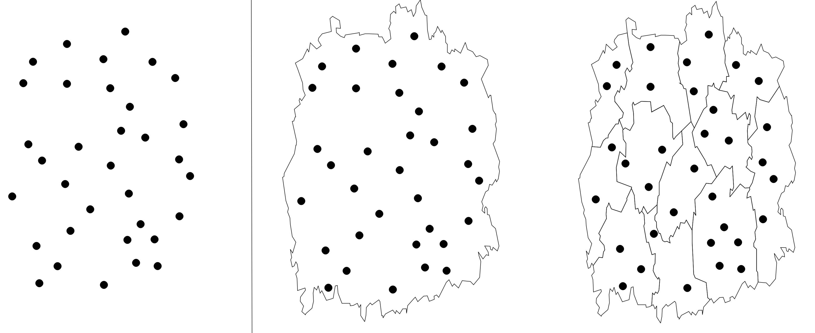
Spatial data: points vs areal units
Background and concepts
Spatial information comes in a variety of forms, with space treated as
a continuous distribution, giving rise to point data with values that can occur at any location in space (e.g., continuous measures of temperature for all points within a region); or,
aggregate, or areal, units with summary values for each unit (e.g., average temperature in a region) which may be then assigned to a representative point such as the region’s centroid

Slide 12
Spatial data: polygons
Background and concepts
In geospatial data, a polygon is a closed shape defined by a sequence of coordinate pairs (vertices) – the first and last coordinate pair are the same and all other pairs are unique
Map regions can be represented by polygons, and analyses may use a representative point (e.g., centroid) for each polygon to define its spatial location and calculate distances to other polygons or points of interest

Slide 13
Spatial data: polygons
Background and concepts
In addition to distances between polygons, we are often also interested in adjacency, i.e., whether or not two polygons share an edge or vertex

Slide 14
Spatial data: geocoding
Background and concepts
raw location is often given by an address (e.g., census unit, postal code, street address, etc.), which must be assigned, or geocoded, to a spatial location, such as lat/lon, prior to analysis
geocoding is the matching of an address to the corresponding geographical coordinates using a reference database (e.g., postal code conversion file)
geocoding is rarely perfect – several sources of uncertainty can obscure the actual location of a particular address; manual work may be needed to generate appropriate coordinates for some addresses

Slide 15
Coordinate reference systems (CRS)
Background and concepts
How do we describe locations (the ‘coordinates’) of our data on the surface of the earth?
a coordinate reference system (CRS) represents locations by coordinate pairs, indicating distance from an origin point
geographic CRS: based on latitude (degrees north/south of equator) and longitude (degrees east/west of Prime Meridian) – every point on Earth is defined by a lat-lon coordinate pair, often written in degrees, minutes, seconds (DMS) or decimal degrees (DD)
projected CRS: based on units (typically meters) from an origin point (a ‘datum’)

Slide 16



Projection systems
Background and concepts
If we simply laid flat the Earth’s curved surface, spatial locations would be warped
Instead, to display spatial information defined by coordinates, we use a transformation (projection), converting location on the Earth’s surface to a location on a flat two-dimensional map

Slide 17
Projection systems
Background and concepts
Many projection systems exist, with differing strengths/ weakness and degrees of warping
conformal - preserves spatial shape over small areas, but larger areas are distorted (e.g., ‘Mercator’)
equal area - preserves area so that relative sizes of regions are correct and comparable (e.g., ‘Albers’ equal-area’)
equidistance - preserves distance measures

Slide 18
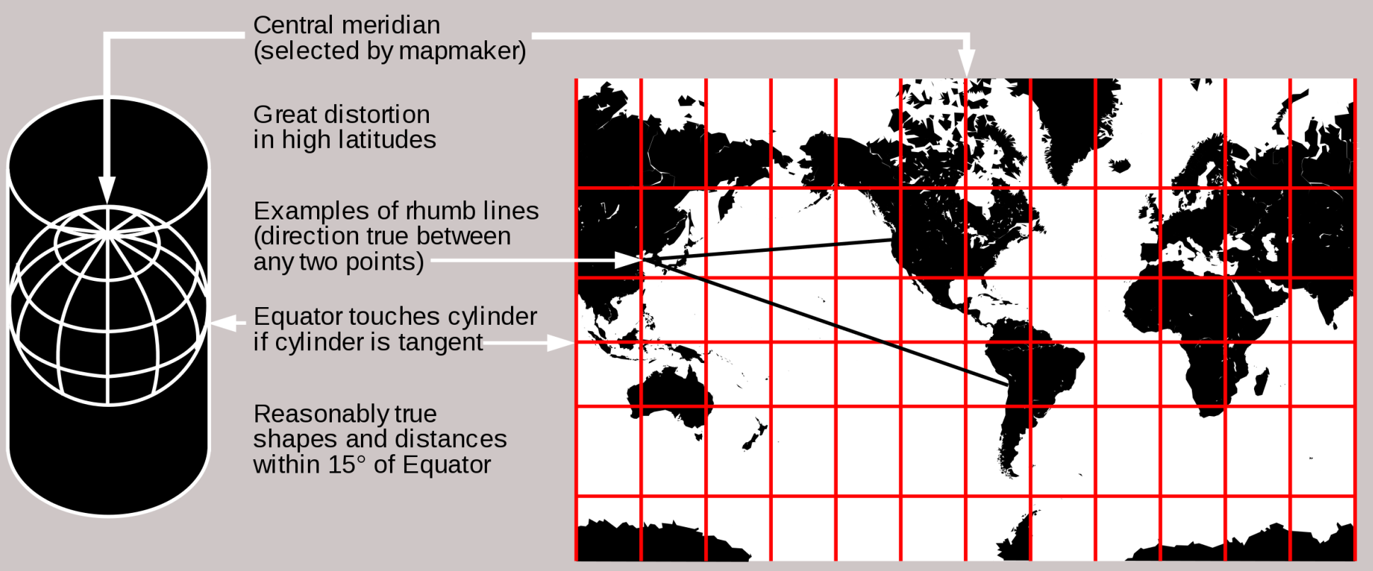
Projection systems
Background and concepts
one consequence of projecting is that scale (map distance:actual distance) is not the same across a map’s surface – reported scales are usually an average
Mercator projection
https://en.wikipedia.org/wiki/Map_projection

Slide 19
Projection systems
Background and concepts
If the purpose is only a quick map, projection of spatial data is not strictly necessary – simple display of lat-lon is adequate
However, if analyses involve measures/comparisons of distance, shape or area, a projected coordinate system should be used
Choice of the projection system depends on what aspects (e.g., distance) must be most accurately preserved

Slide 20
Challenges of spatial data
Background and concepts
Modifiable Areal Unit Problem (MAUP): appearance of false patterns resulting from the aggregation of spatial data into areal units – two aspects of MAUP
scale of aggregation: depending on size (or number) of uniform spatial units used for aggregation, summary statistics can change even though underlying data are the same
zoning: depending on shape of spatial units used for aggregation, summary statistics can change even when the number of spatial units is constant

Slide 21
Challenges of spatial data
Background and concepts
Modifiable Areal Unit Problem (MAUP)
Waller & Gotway 2004

Slide 22
Challenges of spatial data
Background and concepts
In public health, data are often aggregated into areal units (e.g., for calculating rates, ensuring privacy), making MAUP a common and important challenge
There is no perfect solution, be aware of this problem and consider its impact, e.g., how do the results change if I modify the boundaries? What statistical summaries are least impacted by the level of aggregation?

Slide 23
Challenges of spatial data
Background and concepts
Location uncertainty: aside from problems geocoding a specific address, there may still be substantial uncertainty about the appropriateness of a set of coordinates
most people are highly mobile, hence a particular address may not be representative of their location (e.g., home vs work vs recreation)
people move day-to-day (at home, on vacation, etc.) and over many years (multiple home and work addresses) making it difficult to determine accurate locations at specific times

Slide 24
Key sources of spatial data in public health
Background and concepts
health data (e.g., outcome data from routine surveillance programs, administrative health databases, as well as observational and experimental research studies), including vital statistics, reportable diseases, disease registries, national and provincial health surveys
census data (e.g., socio-demographic information collected through formal government census), including population sizes by age, sex, region, counts of housing units, employment and income profiles, education, immigration, family sizes

Slide 25
Key sources of spatial data in public health
Background and concepts
environmental data (e.g., ecological indicators and natural resources routinely monitored by government and other national/provincial organizations), including land use and related characteristics, habitats, agricultural operations and practices, bodies of water and water quality, air quality, climate
remote sensing data (e.g., aerial and satellite imagining data) including, aerial photographs, satellite measures of radiation and sea-surface temperature
other sources?

Slide 26

Considerations and cautions
Background and concepts
Interpretation of spatial data has certain challenges (modifiable areal unit problem, location uncertainty, ecologic fallacy, etc.) that must be considered carefully
Different data sources may use different projection systems – these must be reconciled before data sources can be combined for analysis
specific location information, e.g., street address or corresponding coordinates, can uniquely identify individuals -- care is needed when storing and analyzing such information and it may be necessary to mask locations to protect privacy

Slide 27
Spatial data in R

Slide 28


Background
Spatial data in R
R is a free, open-source statistical software package that can be used for all aspects of data manipulation, analysis and visualisation (https://cran.r-project.org/)
R functions (commands) are organized into packages (also called libraries) that can be loaded as needed
Most R users interface with the R program via RStudio and use command-line code (scripts)
Numerous R packages exist for working with spatial data (see: https://cran.r-project.org/web/views/Spatial.html)
Here, we focus on the new sf (‘simple features’) package (see: https://CRAN.R-project.org/package=sf)

Slide 29
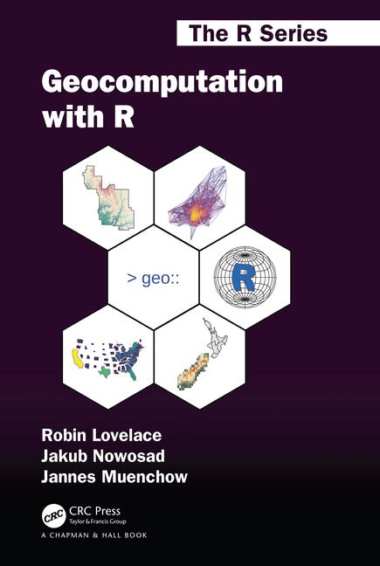
The sf package
Spatial data in R
The sf package is a collection of tools for working with spatial data in R, where ‘sf’ refers to simple features, which are a standard set of geometry types (e.g., point, line, polygon, etc.) supported by the package
sf currently supports tools for vector data only (not raster data)
use of the sf package is described extensively in the free online book Geocomputation with R (https://geocompr.robinlovelace.net/)

Slide 30
The sf package
Spatial data in R
sf data objects appear in R as standard data frames, except with addition of a geometry column containing condensed list of all coordinate information for a particular spatial feature
With a basis in standard data frames, powerful data manipulation tools of R, particularly those in the tidyverse, can be used with sf

Slide 31
The sf package
Spatial data in R
For example, we can work with sf data objects in the same way as any (tidy) data object in R, including chaining commands together (piping) with %>%, using filter to include only certain rows, select to include only certain columns, and mutate to create new derived variables:
world_asia <- world_data %>%
filter(continent == "Asia") %>%
select(name, continent) %>%
mutate(map_col = ifelse(name == “China”, “white”, “grey”))

Slide 32
The sf package
Spatial data in R
sf contains numerous functions (commands) for importing, manipulating, transforming and exporting spatial data – all have intuitive names and begin with the prefix st_
st_read reads spatial data
st_point creates spatial points
st_crs retrieves the data’s coordinate reference system
st_distance calculates Euclidean distance
etc.

Slide 33
Illustrative example

Slide 34
Working with spatial data in R
Illustrative example
R script: Working with spatial data
Introducing
the sf package
spatial data operations
using sf cheatsheet

Slide 35
Discussion

Slide 36
Challenges in accessing and using spatial data
Discussion
What challenges exist for jurisdictions in accessing geospatial data?
What challenges exist for jurisdictions in working with and analyzing geospatial data?

Slide 37
References and resources
Bivand, R.S., Pebesma, E.J., Gómez-Rubio, V. and Pebesma, E.J. 2008. Applied spatial data analysis with R. New York: Springer.
Lovelace, R. 2017. Introduction to visualising spatial data in R. https://github.com/Robinlovelace/Creating-maps-in-R
Waller, L.A. and Gotway, C.A. 2004. Applied spatial statistics for public health data. John Wiley & Sons.
R materials
the sf package [https://geocompr.robinlovelace.net/spatial-class.html]
spatial data and the tidyverse [https://geocompr.github.io/geocompkg/articles/tidyverse-pitfalls.html]
spatial data operations [https://geocompr.robinlovelace.net/spatial-operations.html]

